Slide 1






Lecture Two:
F.F applications
Asst. Lec. Hussien
Y. Radhi
Flip-Flop applications
Flip- Flops can be used in more applications, in this section some of these applications are described briefly:
1- Parallel Data Storage
A common requirement in digital systems is to store several bits of data from parallel lines simultaneously in-group of flip-flops.in digital systems, data are normally stored in a group of bits (usually eight or multiples thereof) that represent numbers, codes, or other information. In figure (1), an example illustrates this application using (D) flip-flop as storage element.
D0 D₁
D₂
D₃
CLK
Q0 Q ₁
Q ₂
Q ₃
Fig 1 four (D) flip-flops parallel data storage
2- Frequency division
When a pulse waveform is applied to the clock input of a J-K flip-flop that is connected to toggle (J = K=1), the Q output is a square wave with one-half the frequency of the clock input. Thus a single flip-flop can be applied as a divide-by-2 device. Figure (2) illustrate how J-K flip-flop can be used as frequency division.

Slide 2





Lecture Two:
F.F applications
1
Asst. Lec. Hussien
Y. Radhi
J
Q
CLK
K
_{𝑸}
CLK
Q
Fig 2 J-K frequency division circuit
HW₁: draw the waveforms of the outputs for (four J-K flip-flops), and what is the frequency of the output waveform of each stage if the frequency of the clock pulse is (16 KHz).
Digital counters
Another application of flip-flops are a counters in all their types such as up, down, …etc.
Registers
The registers are a group of flip-flops connected with each other's. Used for saving information and transfer it, the pest type of flip-flops, which can be used in the design of registers, is (D) flip-flop because the output of (D) flip-flop equal to the d inputs.
Delay Element
The (D) flip-flops can be used as a delay element, which is used in the communication systems, for example when processing the television signal. it is found that the voice signal differs from the picture signal,

Slide 3













Lecture Two:
F.F applications
Asst. Lec. Hussien
Y. Radhi
therefore each one of them is processed and then mixed them by using mixer, and since the processing of picture take along time as compared with voice then it can be late using flip-flop to make them viewed together.
Shift Registers
Shift registers are used to save data and move or shift it to the left or to the right as illustrated in figure (3).
Serial in
Serial out
To left
Serial out
Serial in
To right Fig3 data follow
There are four types of registers:
1- Serial-In Serial-Out (SISO)
In this type of shift register, data follows in serial way either from left to the right or from right to the left. Figure (4-a) and (4-b) shows the two types respectively.
Data i/p Data o/p
D₀
Q₀
D₁ Q1
D₂
Q2 D3 Q₃
CLK
Fig.4- a Left to Right SISO

Slide 4








Lecture Two:
F.F applications
Asst. Lec. Hussien
Y. Radhi
Data o/p
Data i/p
D₀
Q₀
D₁ Q1
D₂
Q₂
D₃
Q₃
CLK
Fig4- b Right to Left SISO
HW₂:design register circuit that convert data from left to right and from right to left at the same time using enable element to control the conversion operation.
2- Serial-In Parallel-Out (SIPO)
In this type shift register, data entered in series and can be taken in parallel way from any (D) flip-flop in parallel way. For example if there is a word of four bits, then one pulse is needed to obtain the outputs from each flip-flop. The block diagram of this shift register is shown in figure (5).
Data i/p
Data o/p
D₀
Q₀
D₂
D₁ Q1 Q₂
D3 Q₃
CLK
Q₀
Q₁
Q₂
Q₃
Fig.5- SIPO

Slide 5






























Lecture Two:
F.F applications
Asst. Lec. Hussien
Y. Radhi
3- Parallel-In Serial-Output (PISO)
For a register with parallel data inputs, the bits are entered simultaneously into their respective stages on parallel lines rather than on a bit-by-bit basis on one basis on one line as with serial data inputs. Figure (6) shows (PISO) shift register.
Shift Load
D₂
D₀ D₁ D₃
o/p
D Q0
D Q1
D Q2
D Q3
CLK
Fig.6 PISO shift register
4- Parallel- in Parallel Out (PIPO)
In this type of shift register data transferred in parallel way and entered at the same time. The block diagram of (PIPO) is given in figure
(7). D0 D₁
Data i/p
D₂ D₃
Data o/p
D₀
Q₀
D₁
Q₁
D₂ Q₂
D₃
Q₃
CLK
Q₀ Q₁
Fig.7PIPO shift register
Q₂
Q₃

Slide 6
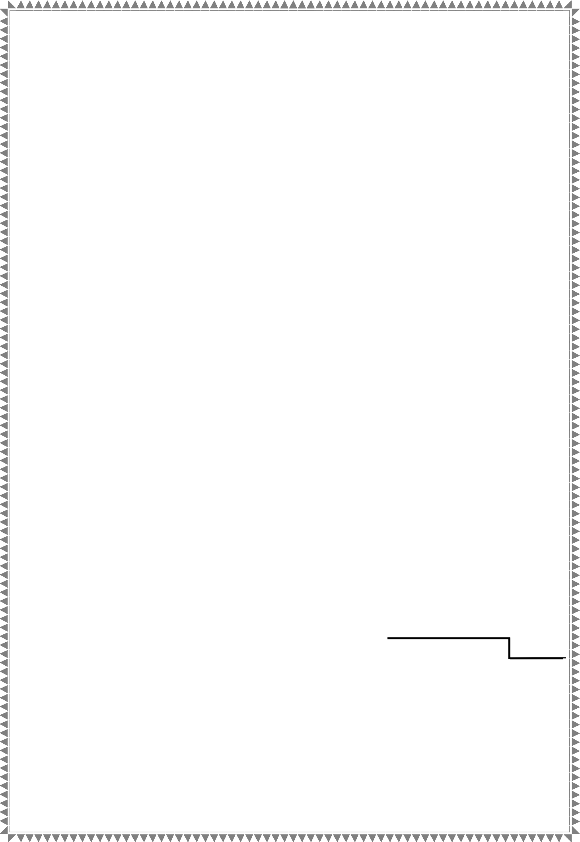


Lecture Two:
F.F applications
Asst. Lec. Hussien
Y. Radhi
Ex1/ design a register that transfers the data (1100110) to the left using four (D) flip-flops, and draw the outputs of these flip-flops after seven pulses.
Sol:
Data i/p
Data o/p
D₀
Q₀
D₁ Q1
D₂
Q2 D3 Q₃
CLK
The waveforms for the outputs of flip-flops are shown in the following figure.
CLK
Data
Q₀
Q₁ Q₂ Q₃

